Slide 1
CST499 Final Project
Presented by Jaime Aviles

Slide 2

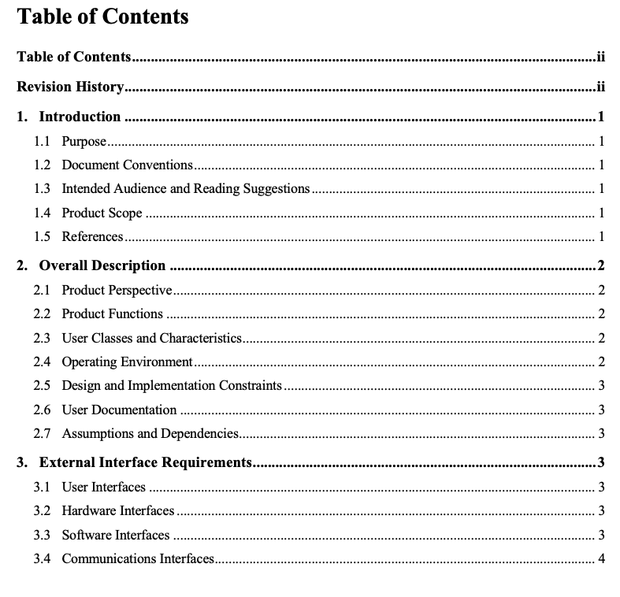
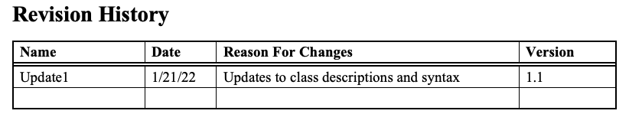
Software Requirements Specification
A software requirement specification (SRS) is a document that outlines the requirements and specifications for a software system. It is a formal statement of what a software system should do and serves as a blueprint for the software development process (Tsui, Karam, & Bernal, 2018).
No huge revisions from the main document.

Slide 3
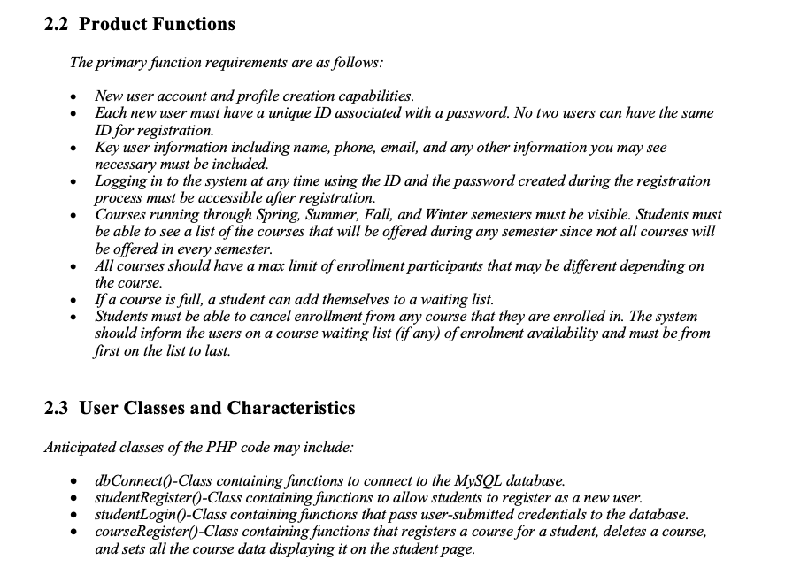
Software Requirements Specification
Updated minor control and syntax of paragraphs throughout the document.
Most updates were in the ‘Product Functions’ Section.
Updated the originally suggested classes with the actual classes used in the PHP code.

Slide 4
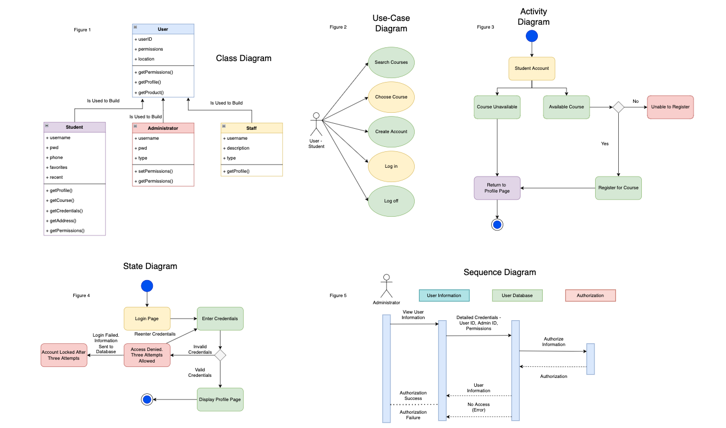
Unified Modeling Language (UML) Designs
The Unified Modeling Language (UML) is a graphical language used in object-oriented development, which includes various types of system models that offer different perspectives of a system. Due to its wide acceptance and usage, UML has become the standard for object-oriented modeling (Sommerville, 2016).
Consist of Class, Activity, State, and Sequence UML Diagrams

Slide 5
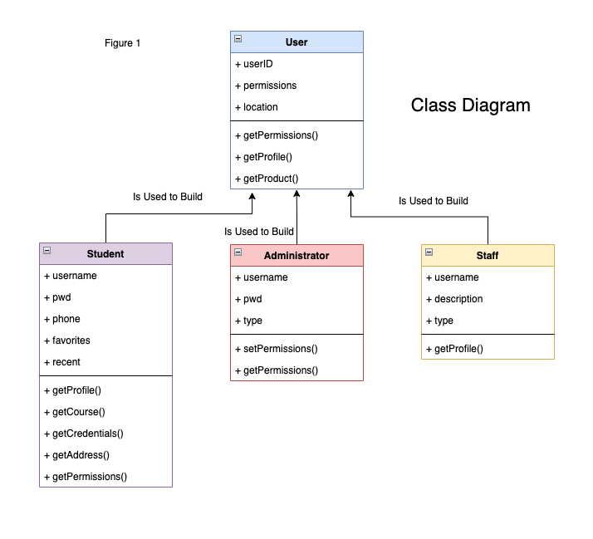
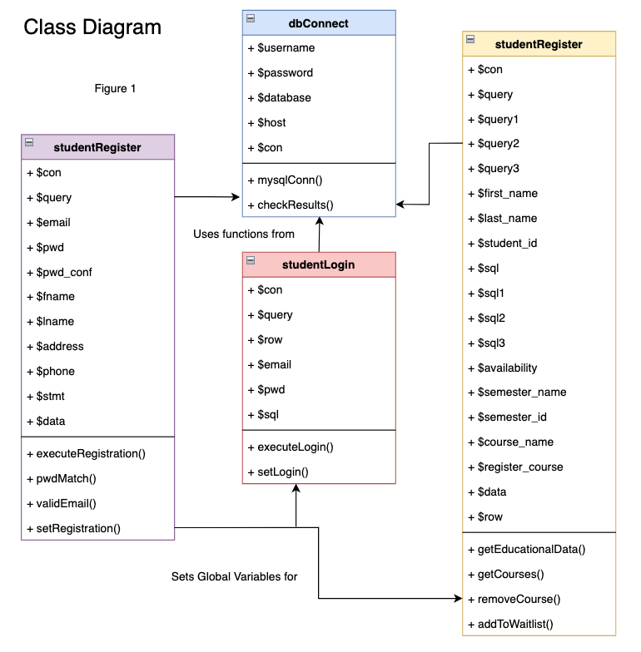
UML Designs major Updates

Slide 6
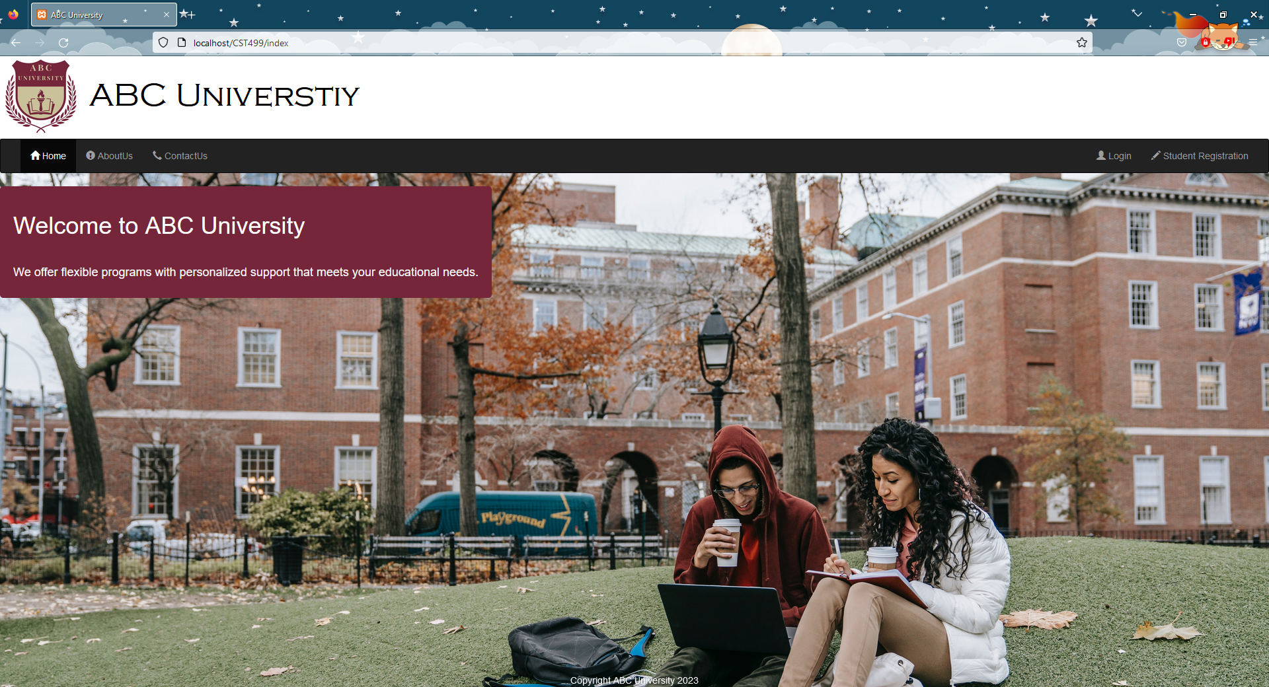
Landing, Login, and Enrollment Pages
Notes:
Here I decided to go with an aesthetic that contained a custom university logo, the navigation bar, and an inviting background. I chose maroon as the color as it is attractive to many people and it is a color that stands out.

Slide 7

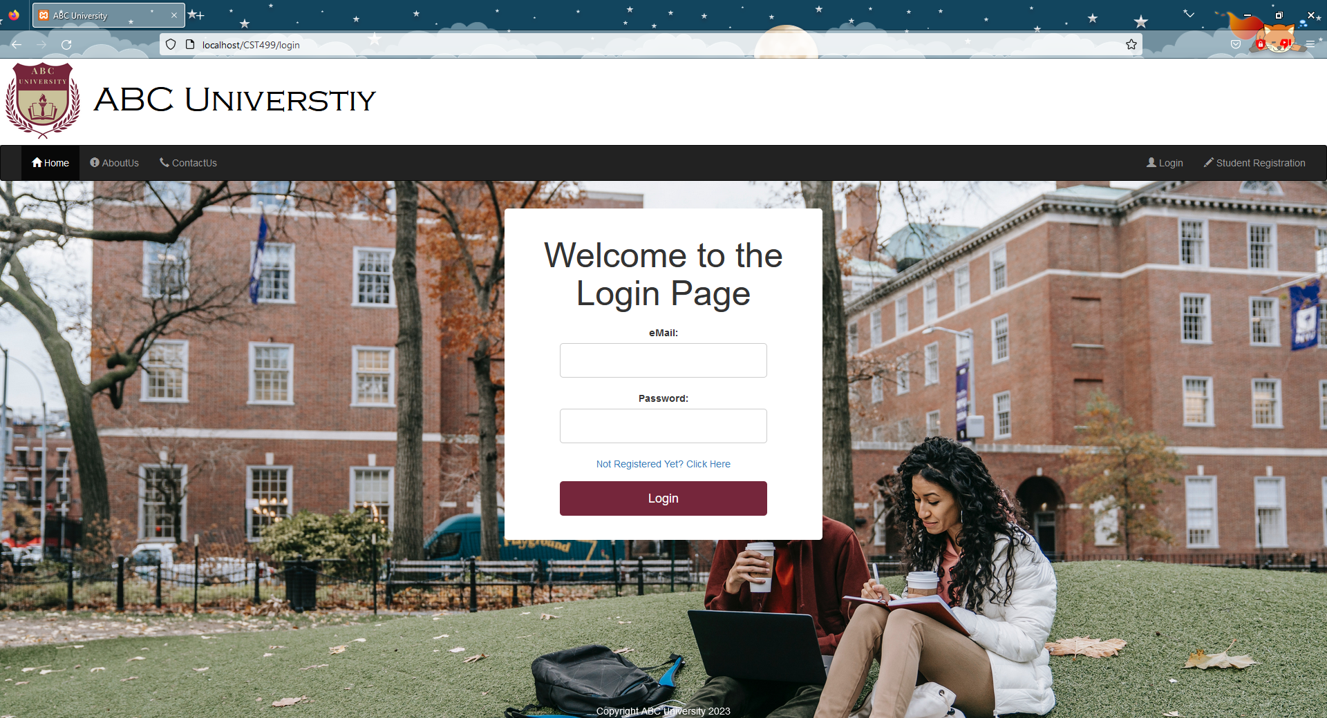
Login Page
Used a simple centered container with a white background. Imports all assets from the master PHP file.
Contains labels, entry boxes, and a single button.
Link to the registration page if not already registered.
Matched button to the color aesthetic.

Slide 8
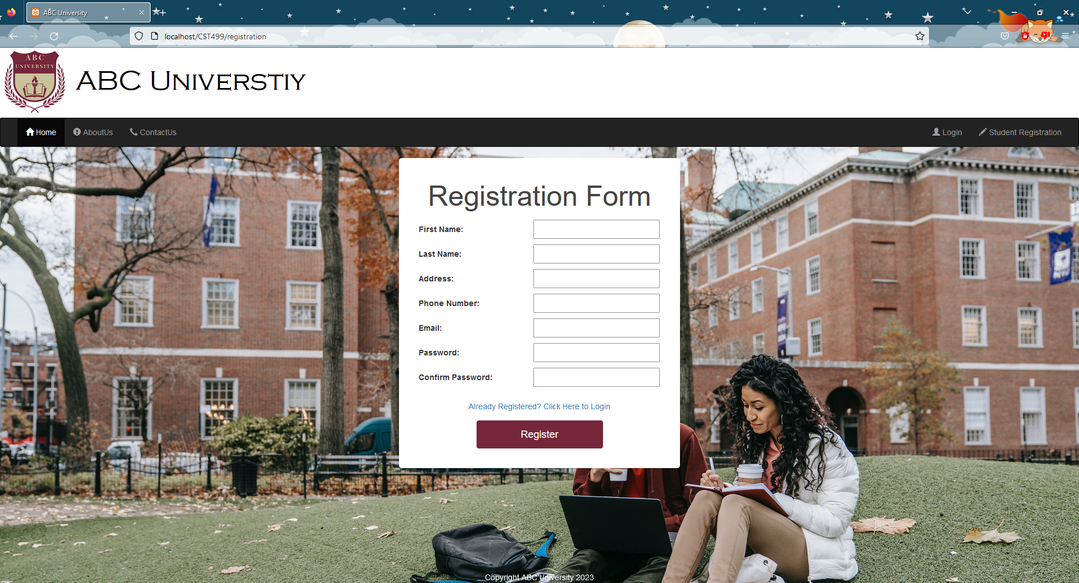
Enrollment Page
Same theme as the ‘Login Page’.
Contains labels, entry boxes, and a single button.
Link to the login page if not already registered.
Matched button to the color aesthetic as well.

Slide 9
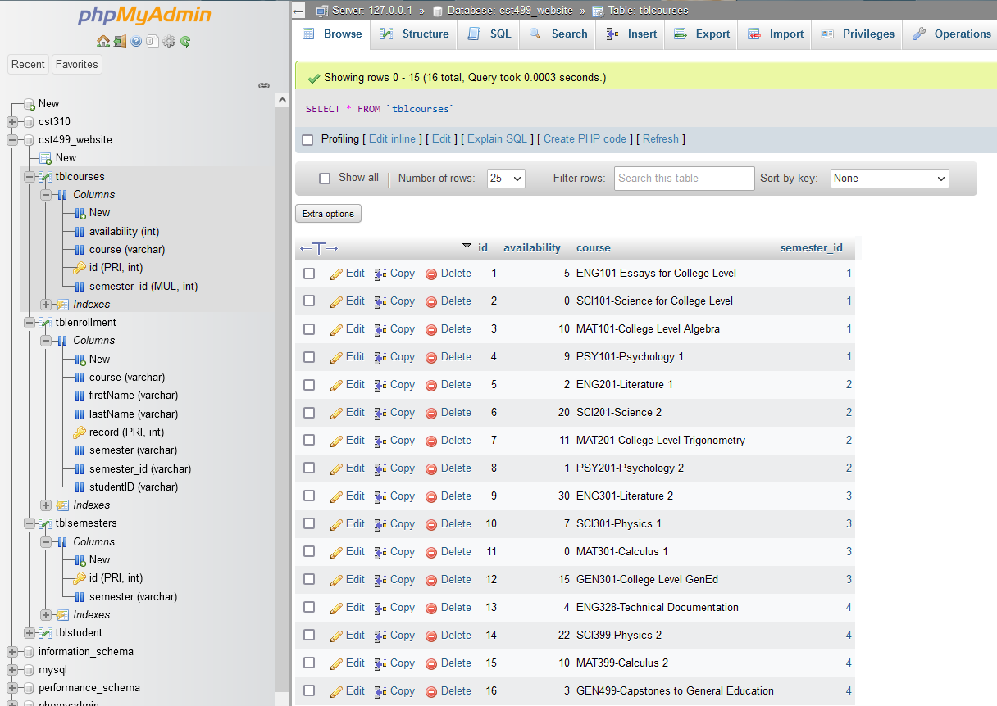
MySQL Database and Class Registration
The registration process works in tandem with a MySQL Database.
Focused on user information, university semester data, and course information.
Contains tables for student, semester, course, enrollment, and waiting list.

Slide 10
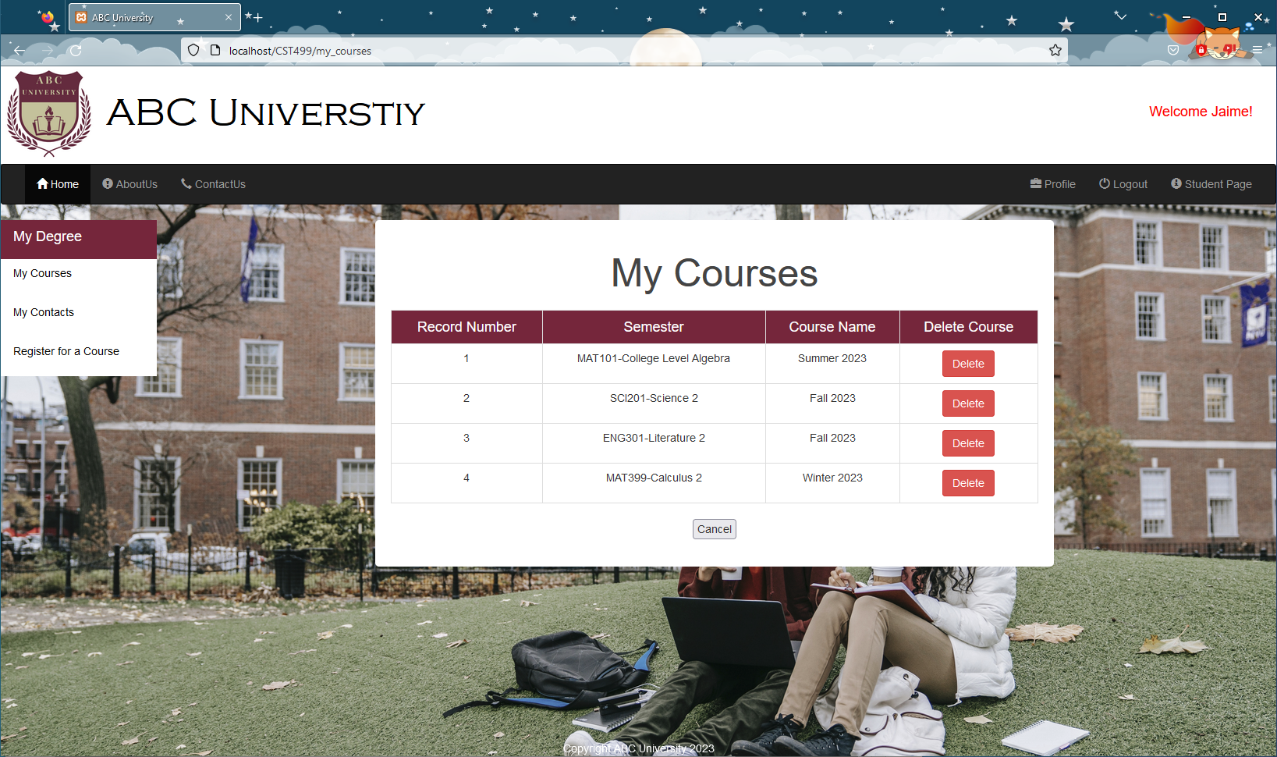
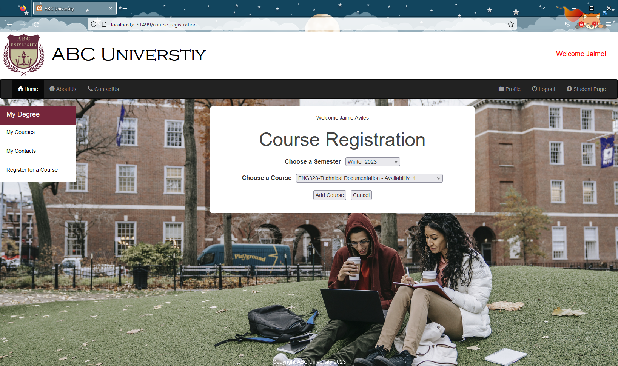
Register for a course and Student courses pages
The course registration page uses a dynamic dropdown menu to pull semester and course information from the database.
The ‘My Courses’ page displays course information in a table format that allows students to delete courses.
Both pages display success and error messages after a specific action.

Slide 11
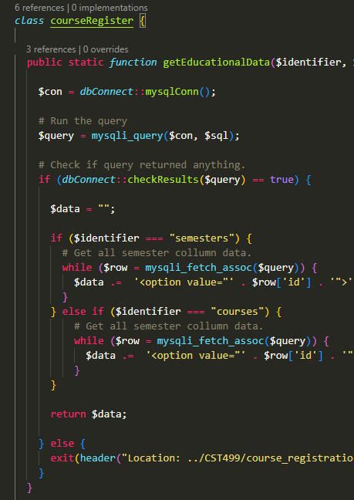
PHP Code
Similar to C-type languages in syntax and control.
Made good use of built-in functions to access the MySQL database.
Can be incorporated into HTML format to display webpage items.

Slide 12
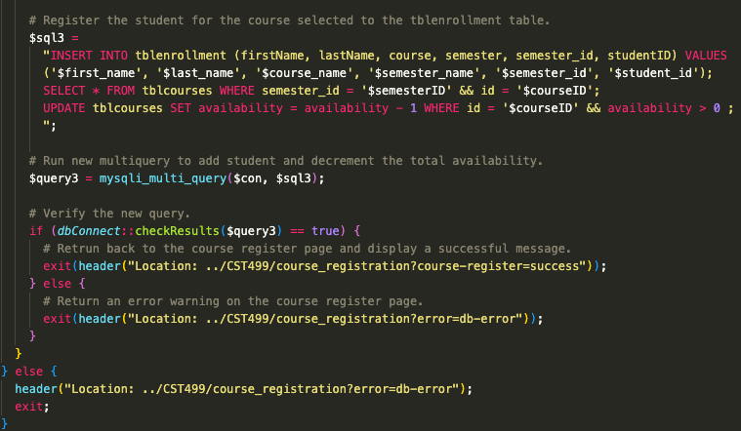
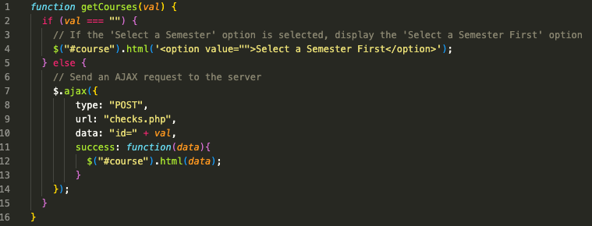
PHP Code
Made use of multiple SQL queries using `mysqli_multi_query( )` function, which sends them asynchronously before returning control back to the PHP process (PHP: Mysqli::Multi_Query - Manual, n.d.).
Utilized jQuery, JavaScript, and Ajax to get semester and course data.
Total lines of code for all pages combined: 1185.

Slide 13


Slide 14
References:
PHP: mysqli::multi_query - Manual. (n.d.). https://www.php.net/manual/en/mysqli.multi-query.php
Sommerville, I. (2016). Software engineering (10th ed.). Pearson.
Tsui, F., Karam, O., & Bernal, B. (2018). Essentials of software engineering (4th ed.). Jones & Bartlett Learning.

